Slide 1
Addressables
Advanced Unity

Slide 2
Content
The Issue
Build Contents/Package
Direct references
Resources Folder
Result
Asset Bundles
Addressables
Package
Address
Groups
Content Loadout Strategy
Asset Reference
Asset Duplication
Extra resources
Exercise

Slide 3
The Issue

Slide 4



Slide 5
The Issue
Build Contents/Package
Direct references
Resources Folder
Result

Slide 6
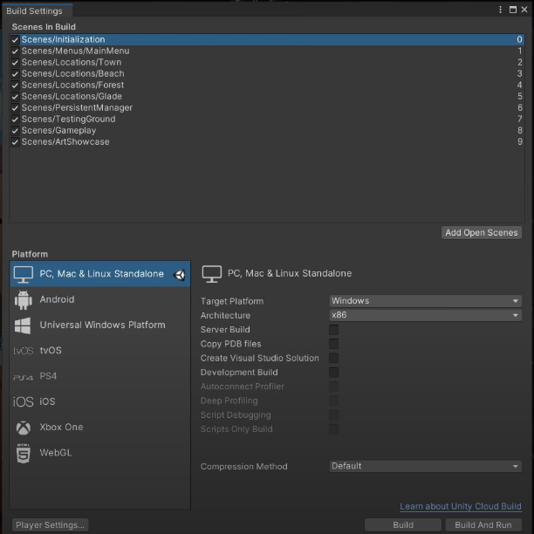
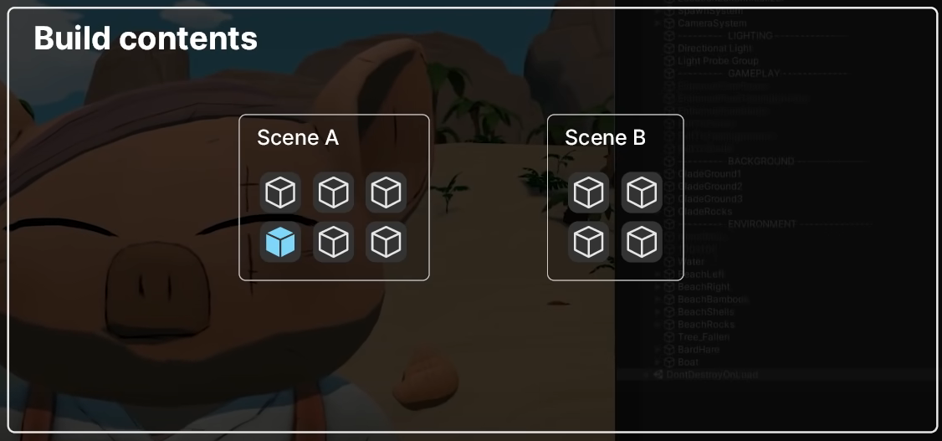
The Issue - Build Contents/Package

Slide 7
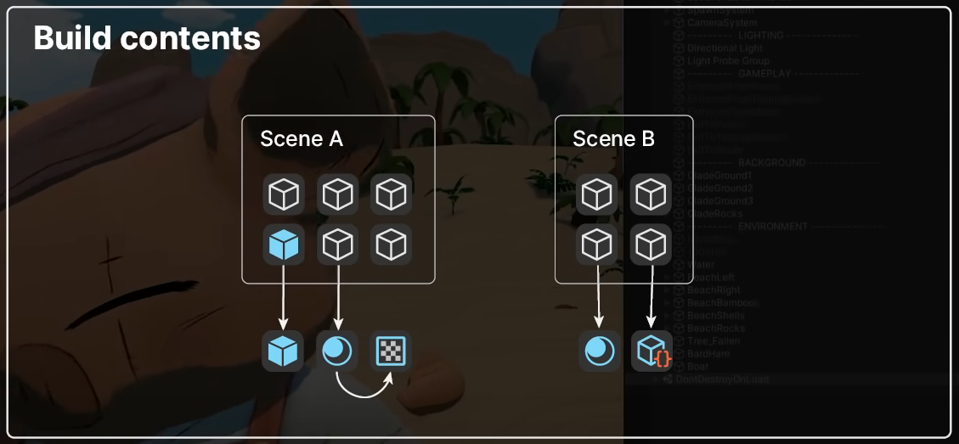
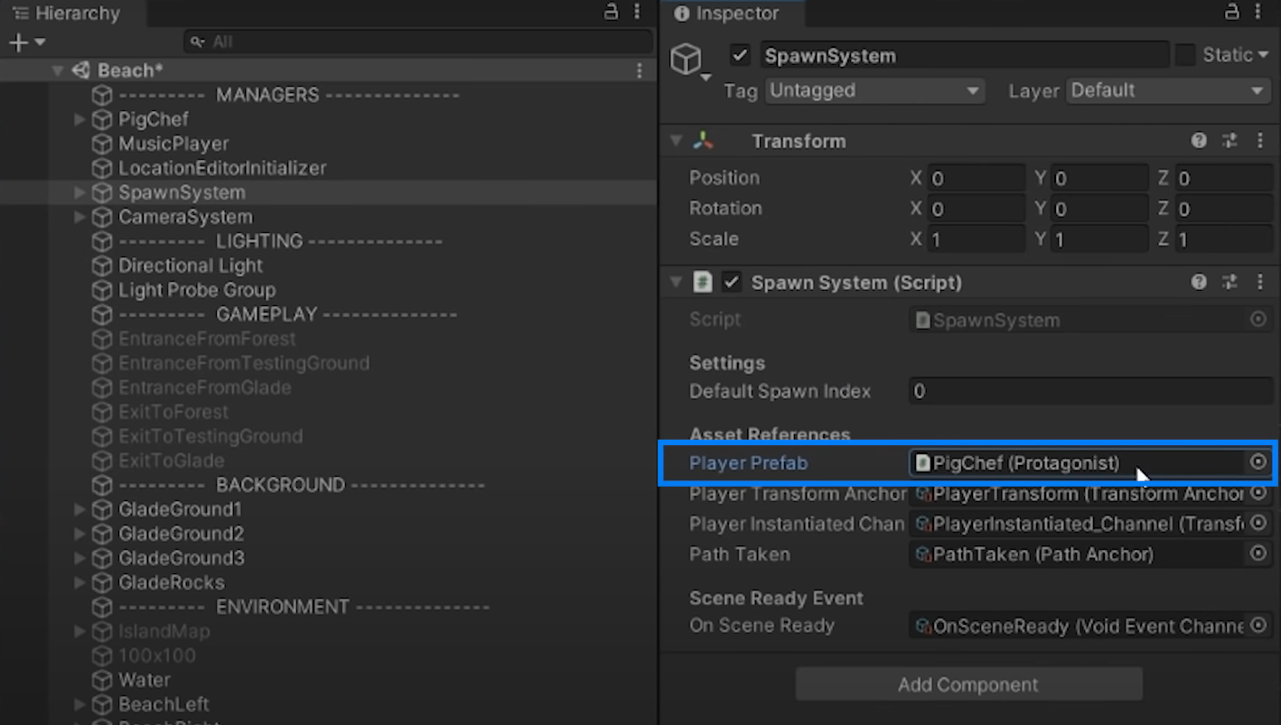
The Issue - Direct References

Slide 8
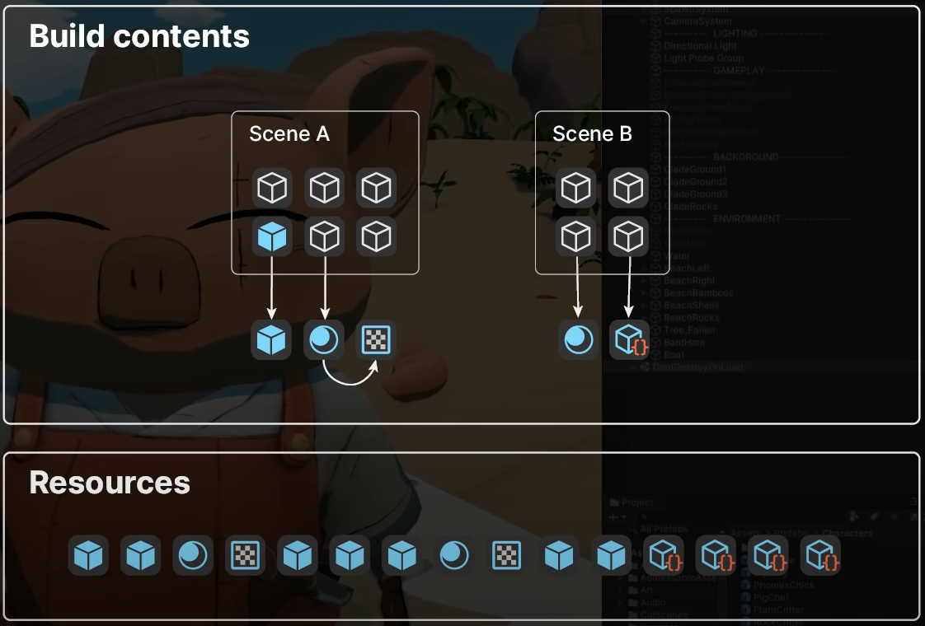
The Issue - Resources Folder
This Compressed File has a maximum capacity of 4GB!

Slide 9
The Issue - Result
Hiccup/Long Loading times
Console: Certification Process Rejection
Mobile: Bad Review/Uninstall

Slide 10
What’s the REAL cause of this issue?

Slide 11
Minimum Load control
No Unload control

Slide 12
How can we fix this?

Slide 13
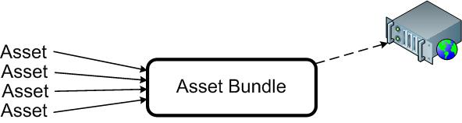
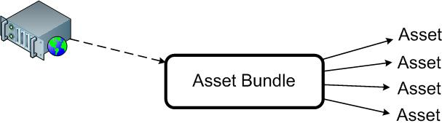
Asset Bundles
AssetBundles are files which you can export from Unity to contain Assets of your choice.
This allows you to stream in content, such as models, Textures, audio clips, or even entire Scenes, separately from the Scene in which they will be used.
AssetBundles have been designed to simplify downloading content to your application.

Slide 14
Asset Bundles II
Cons:
Requires a manual configuration for EVERYTHING
Dependency between bundles needs to be set up manually (error prone)
Requires a lot of code to make it work
Pros:
Works in every Unity version

Slide 15


Slide 16

Addressables
System created to replace AssetBundles system
Addressables simultaneously opens up the world of asset bundles while managing all the complexity.
The Addressable Asset System allows the developer to ask for an asset via its address.
Once an asset (e.g. a prefab) is marked "addressable", it generates an address which can be called from anywhere. Wherever the asset resides (local or remote), the system will locate it and its dependencies, then return it.
Addressables use asynchronous loading to support loading from any location with any collection of dependencies.
Whether you have been using direct references, traditional asset bundles, or Resource folders, addressables provide a simpler way to make your game more dynamic

Slide 17
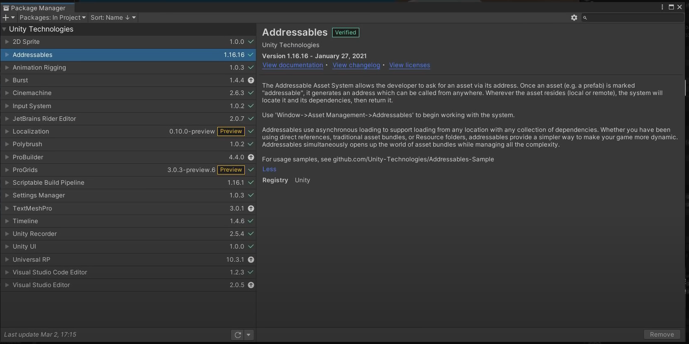
Addressables - Package

Slide 18
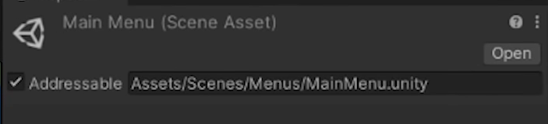
Addressables - Address
This is what we call an “Address”

Slide 19
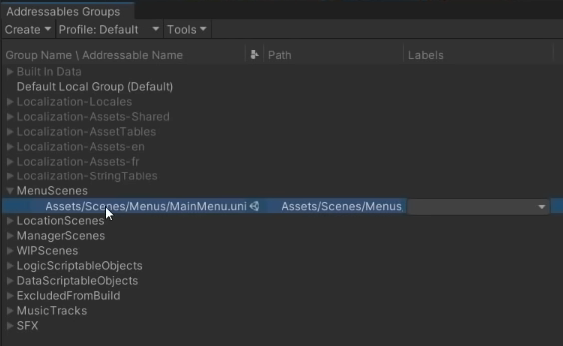
Addressables - Groups
Window->Asset Management->Addressables

Slide 20
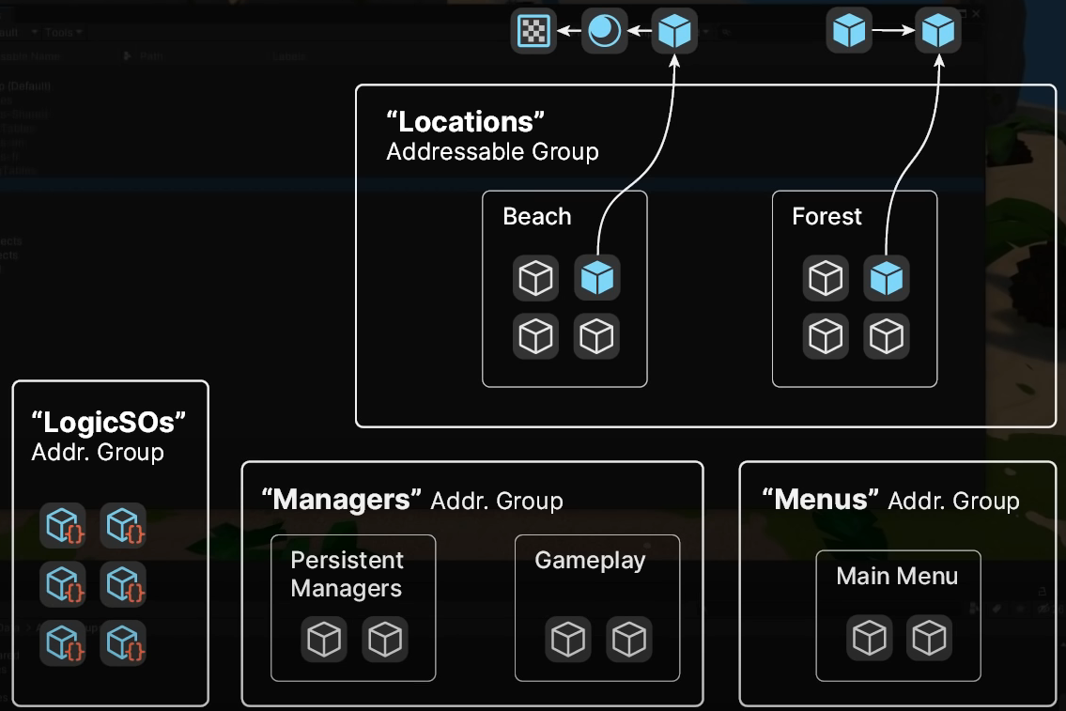
Addressables - Groups

Slide 21
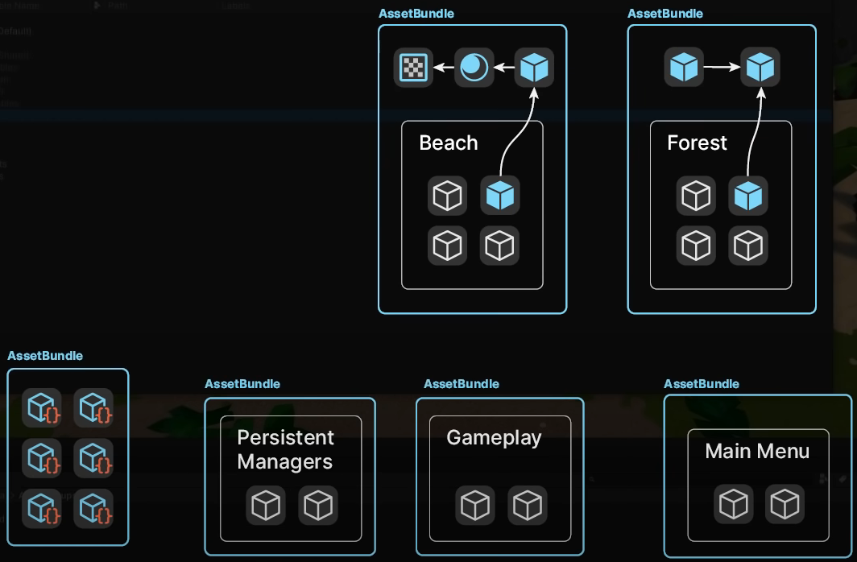
Addressables - Define content loadout strategy
Remember that Unity always requires to have at least ONE scene in the build

Slide 22
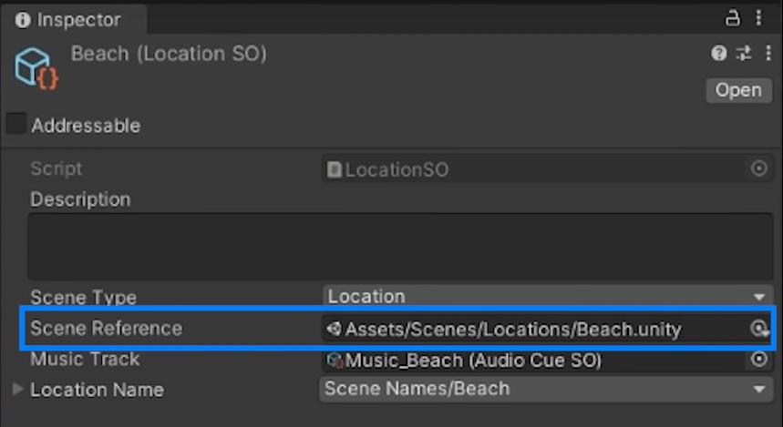
Addressables - Asset References
They are the “promise” of a reference

Slide 23
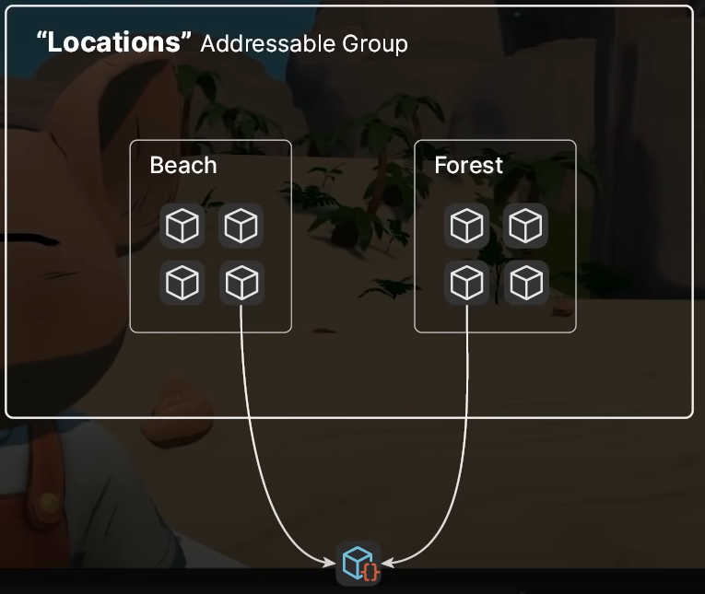
Addressables - Asset Duplication

Slide 24
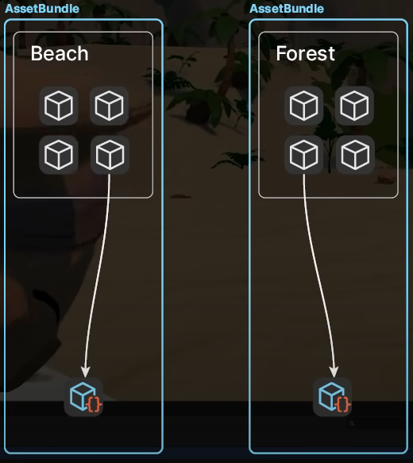
Addressables - Asset Duplication

Slide 25
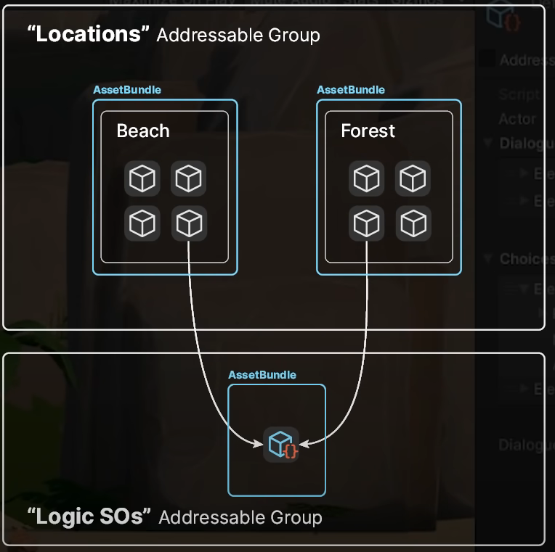
Addressables - Asset Duplication

Slide 26
Useful links to learn deeper about the subject:
Documentation: https://docs.unity3d.com/Manual/AssetBundlesIntro.html
Advanced notes: https://learn.unity.com/tutorial/assets-resources-and-assetbundles#5c7f8528edbc2a002053b5a8
Projects Samples: https://github.com/Unity-Technologies/Addressables-Sample

Slide 27
Exercise together
Create two scripts:
Spawner, Mono Script to spawn a cube prefab once a button is pressed
SelfDestruct, Mono Script attached to the cube, that will destroy the cube after 2s
Try to achieve the same behaviour, but now using Addressables, profiling the load/unload of items
Notes:
Install Addressables package
Create cube, assign SelfDestruct script, and UI Spawner with button
Create first group: Window->AssetManagment->Addressables->Groups
Set address in the cube
Adaptar el script de Spawner
Mostrar el profiler sin adaptar el destruct, para mostrar las instance counts
Addressable Settings activar el Profiler (Send Profiler events)
Explicar el “buildeo” de assetbundles
Explicar como generar sin querer memory leaks
Enseñar lo que pasa al cambiar de escenas

